Slide 1
Research Computing Committee
20 July 2020

Slide 2
Research Computing Committee
2
Agenda
Introductions and purpose of committee
Agree Secretary of Committee
Current status of RC resources
Draft of Research Computing strategy
Plans for CMHS Data and Research Coordinating center
Recommendations for Research Computing survey
AOB
Date of next meeting

Slide 3
Research Computing Committee Charter
3
Committee Charter
Purpose
A forum to discuss and make recommendations regarding KU’s research computing requirements, strategies, allocation of resources, policies and standards.
Ensure that research computing strategies and plans are aligned with KU’s research needs and objectives
Evaluate KU research computing needs, challenges and options
Advise and recommend direction and priorities for research computing investments, including research software, infrastructure and staff.
Review, recommend and advise on relevant processes and procedures for research computing services
Reviews relevant existing policies and recommends revisions as appropriate
Makes recommendations regarding possible new policies, e.g. related to data management
.

Slide 4
Research Computing Committee Charter
4
Committee Charter
Membership and meetings
Membership to include:
Research Computing
Two faculty representatives from each of the Colleges of Arts and Sciences, Engineering and CMHS
An ANKABUT representative
Meetings to be help once a quarter, and more if required

Slide 5
Research Computing Committee
5
Agenda
Introductions and purpose of committee
Agree Secretary of Committee
Current status of RC resources
Draft of Research Computing strategy
Plans for CMHS Data and Research Coordinating center
Recommendations for Research Computing survey
AOB
Date of next meeting

Slide 6
Research Computing Committee
6
Agenda
Introductions and purpose of committee
Agree Secretary of Committee
Current status of RC resources
Draft of Research Computing strategy
Plans for CMHS Data and Research Coordinating center
Recommendations for Research Computing survey
AOB
Date of next meeting

Slide 7
Research Computing Current resources
7
KU HPC Cluster
HPC located at Masdar City
Heavily used and ageing.
Will be losing data centre at Masdar. No timeline yet.
Need to make plans to migrate data and decommission h/w.
SAN HPC Cluster
Located at ADRIC, on SAN campus. Belongs to ADNOC
Moderately used, and ageing.
Will be decommissioned at end of 2020.
New HPC Procurement via ANKABUT
Final stages of technical evaluation
To be located on main campus
Aiming for end of year, or early 2021 to begin service

Slide 8
Research Computing Current resources
8
Comparison of performance
Masdar Campus Cluster |  | Components | Number of Nodes | Theoretical Peak Performance (Rpeak) Teraflops | Achieved Performance (Rmax) Teraflops
 | CPU Compute Nodes | 2x Intel Xeon E5-2690 v3 12-Core 2.6GHz (Haswell - 2014) | 64 | 62.4 | 48.8
 |  | 2x Intel Xeon E5-2697 v2 12-Core 2.7GHz (Ivy Bridge - 2013) | 16 | 8.1 | 7.7
 | GPU Accelerated Nodes | 2x Intel Xeon E5-2695 v2 12Core 2.4GHz (Ivy Bridge) and dual GPU Nvidia K20M | 4 | 11.2 | 8.9
SAN Campus Cluster | CPU Compute Nodes | 2x Intel Xeon E5-2690 v3 12-Core 2.6GHz (Haswell - 2014) | 41 | 24.6 | 19
 |  | 2x Intel Xeon E5-2697 v2 12-Core 2.7GHz (Ivy Bridge - 2013) | 23 | 4.9 | 3.97
 |  | 2x Intel Xeon E5530 4-Core 2.4GHz (Nehalem - 2009) | 9 | 0.7 | 0.59
 | GPU Accelerated Nodes | 2x Intel Xeon E5-2630 v3 8-Core 2.4GHz (Haswell) and 4x GPU Nvidia K80 | 6 | 48.5 | 38.8
 | Total for existing clusters |  | 163 | 160.3 | 127.8
Proposed New Cluster | CPU Compute Nodes | 2X Intel Xeon Gold 6238 22-core 2.1Ghz (Cascade Lake - 2019) | 80 | 231 | 184.8
 | GPU Accelerated Nodes | 2X Intel Xeon Gold 6238 22-core 2.1Ghz (Cascade Lake - 2019) and four GPU Nvidia Tesla V100 cards | 3 | 92.66 | 74.13
 | Total for new cluster |  | 83 | 323.66 | 258.93

Slide 9
Research Computing Current resource utilization
9
KU Cluster core distribution

Slide 10
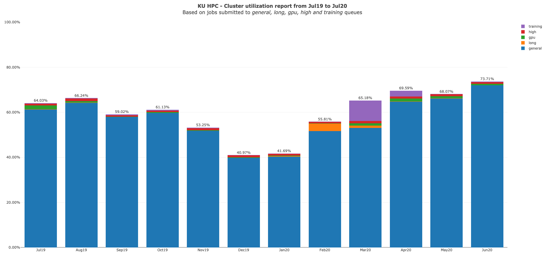
Research Computing Current resource utilization
10

Slide 11
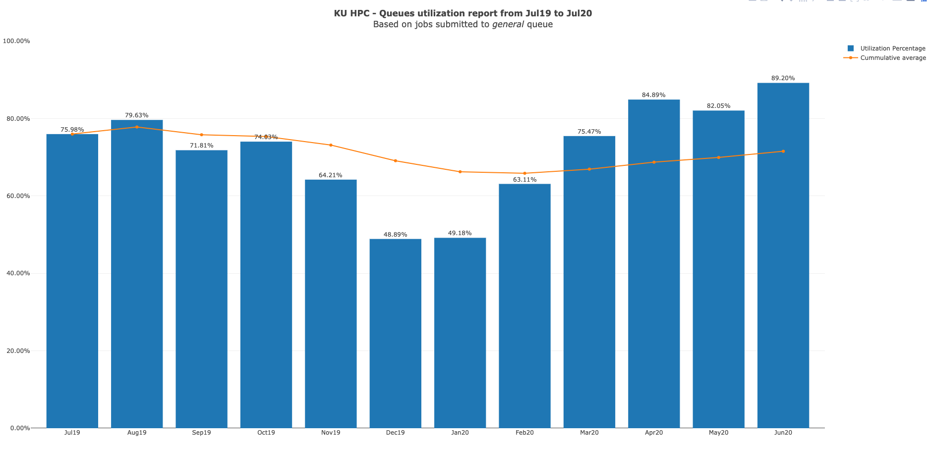
Research Computing Current resource utilization
11

Slide 12
Research Computing Current resource utilization
12
SAN Cluster core distribution

Slide 13
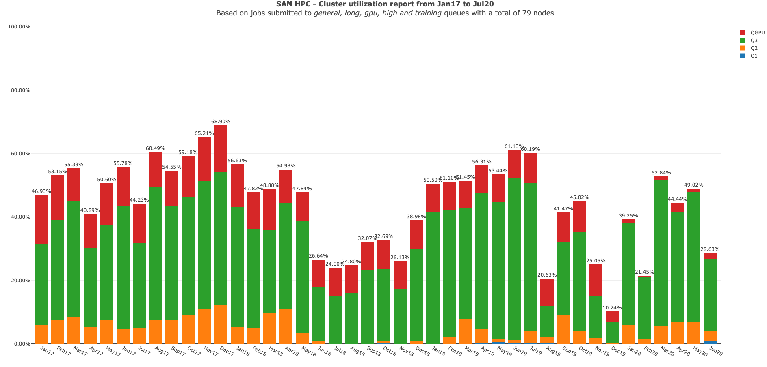
Research Computing Current resource utilization
13

Slide 14
Research Computing current status
14
Training
“Research Computing intro session”, “Introduction to Linux”, and “Introduction to HPC” courses are all well attended and well received.
Due to course being online, places are limited to 5 per session.
All three courses are delivered on a weekly basis.
Schedule is three courses per week, and sending out invites at beginning of the month.

Slide 15
Research Computing Committee
15
Agenda
Introductions and purpose of committee
Agree Secretary of Committee
Current status of RC resources
Draft of Research Computing strategy
Plans for CMHS Data and Research Coordinating center
Recommendations for Research Computing survey
AOB
Date of next meeting

Slide 16
Research Computing High Level Strategy
16
Research Computing high-level strategy
Goals
Different levels of computational requirements
Software
Data Storage
Support

Slide 17
Research Computing High Level Strategy
17
Goals
Sustainability
Computer based modelling and simulation firmly established as integral parts of scientific research
Provision of resources needs to be consistent and sustainable.
This would entail periodic investment by KU. Appropriate life-cycle management needs to be implemented.
Notes:
Sustainability: Provision of research computing hardware resources needs to be consistent and sustainable. This would entail periodic investment by KU. Alongside this, appropriate life cycle management needs to be implemented;useful lifetime of equipment needs to be defined, the equipment then repurposed and retired as appropriate.

Slide 18
Research Computing High Level Strategy
18
Goals
Multiple Levels of Computation
One size does not fit all
Requirements range from powerful workstations, to cloud services, university level HPC as well as large scale/national level HPC
Need to develop efficient and simple mechanisms for capturing and satisfying these requirements
Medium level Computation
Some computational tasks cannot be carried out on standard laptops/desktops but are not suited to High Performance Computing (HPC) clusters.
Centralize where possible, through providing access to private cloud and virtual machines/labs
Use public cloud for test beds and services not available locally
This will simplify management, security and data protection, provisioning, access to software and remove system administration burden from researchers
Notes:
Multiple levels of computation: It is important to acknowledge that one size does not fit all, and that there multiple levels of computational requirements across research. These would range from workstations, to cloud services, university level HPC as well as national level supercomputer access. Processes and mechanisms for capturing and satisfying all of these requirements need to be developed. It is crucial that these mechanisms and processes be as simple and efficient as possible and easily accessible to KU researchers.

Slide 19
Research Computing High Level Strategy
19
Goals
High Performance Computing
Replace current ageing cluster with an HPC cluster of adequate size to enable researchers to produce results in a timely manner as well as explore new research topics.
Allow researchers to develop skills and tools required to make use of larger scale HPC.
HPC should be accessible to all who require it, permit access to funded and unfunded research and researchers should be actively encouraged to use the service.
Establish mechanism to expand resources using external grant funding for projects that require a higher level of provision. These can be dedicated to the project or shared with a common pool.
Assist researchers with accessing larger HPC resources, where appropriate. These could include large scale/national level HPC, such as at KAUST, or from commercial cloud providers.

Slide 20
Research Computing High Level Strategy
20
Goals
Data Storage
Underlying all computational resources, should be robust and reliable storage services, which conform to some basic principles:
Data Management: Provide tools, processes to allow researchers to comply to KU data management policies
Tiered Storage: Services should span multiple performance and functional requirements, ranging from HPC storage to long term backup
Accessibility: Accessible from a variety of computing platforms, without jeopardizing security
Funding & allocation: Should be funded and run centrally. Processes for resource allocation will need to be established
Expandability: Establish mechanism to expand storage using external grant funding for projects that require a higher level of provision

Slide 21
Research Computing High Level Strategy
21
Goals
Software
Though progress has been made to streamline the funding, purchasing and consolidation of software licenses, this can be improved.
Only a small number of software applications widely used by researchers currently funded via Research Computing. Typically site licensed software, and/or used across multiple departments
Need to establish a process to determine which software should be funded centrally.
The aim is to simplify management, and streamline purchasing. This may also enable monitoring the utilization of licenses, to help with making decisions about the level of license provision.

Slide 22
Research Computing High Level Strategy
22
Goals
Support
Work in conjunction with researchers to design and implement bespoke computing resources to support research projects.
Support researchers by understanding their research computational needs and recommend suitable applications and other research computing resources available at the University.
Develop and maintain documentation and guidelines to assist users to make use of computational resources
Provide scientific computing support.
Evaluating, optimizing and deploying new software on the HPC clusters
Application profiling and performance evaluation
Continue to develop and deliver specialized training courses.

Slide 23
Research Computing Committee
23
Agenda
Introductions and purpose of committee
Agree Secretary of Committee
Current status of RC resources
Draft of Research Computing strategy
Plans for CMHS Data and Research Coordinating center
Recommendations for Research Computing survey
AOB
Date of next meeting

Slide 24
Research Computing Committee
24
Agenda
Introductions and purpose of committee
Agree Secretary of Committee
Current status of RC resources
Draft of Research Computing strategy
Plans for CMHS Data and Research Coordinating center
Recommendations for Research Computing survey
AOB
Date of next meeting

